Slide 1
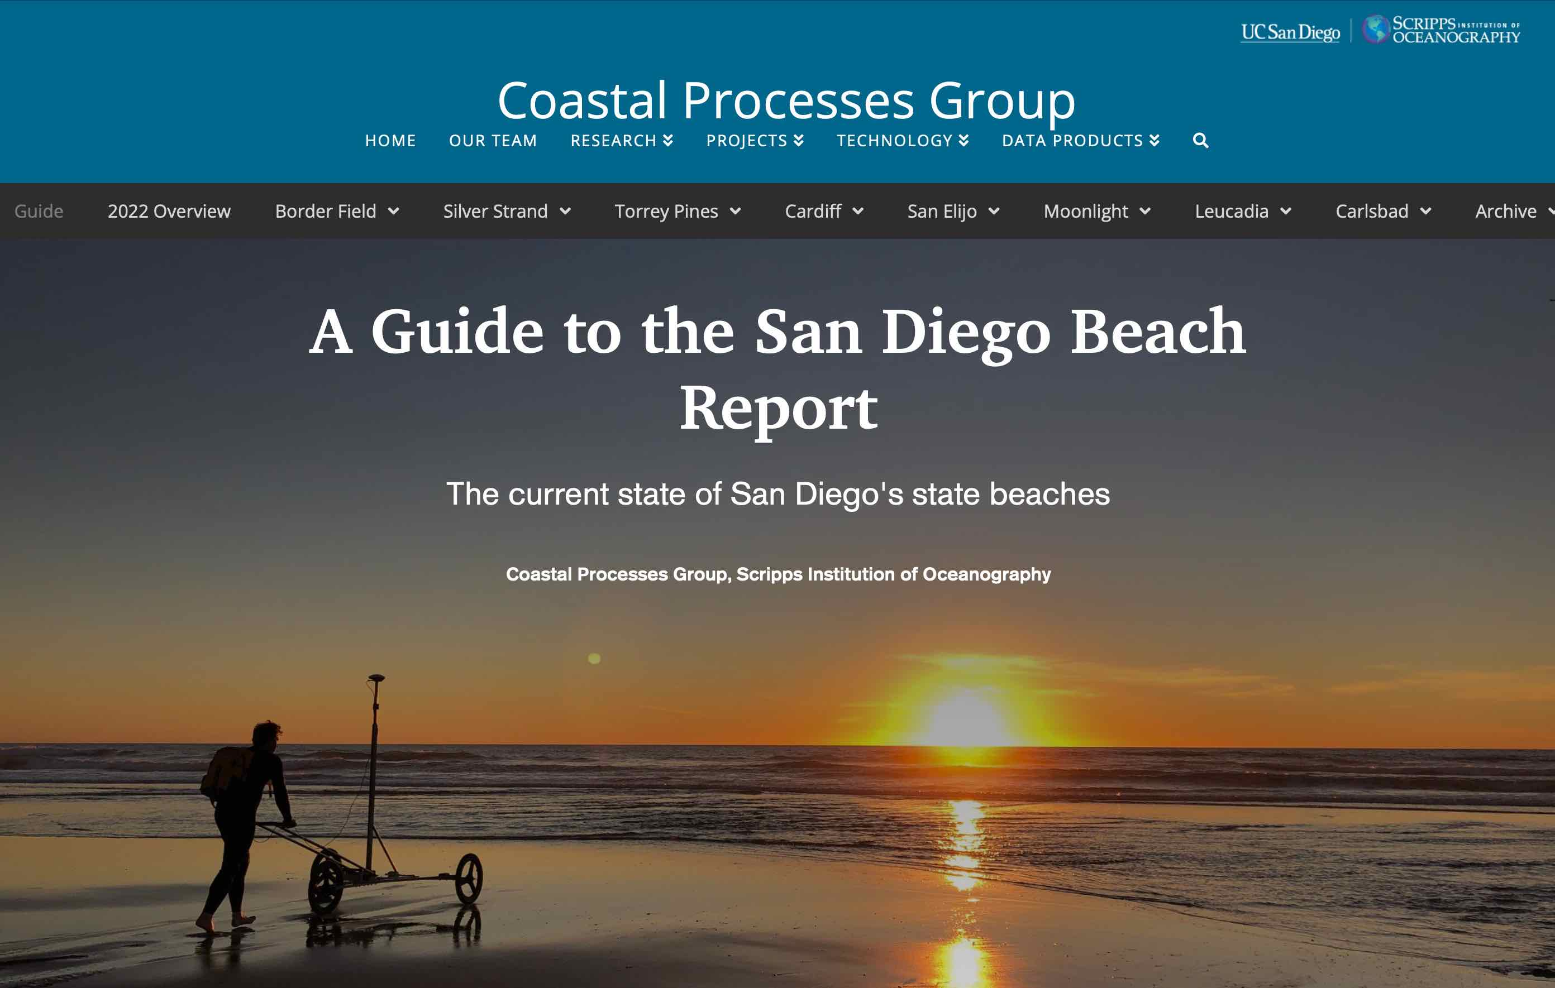
https://siocpg.ucsd.edu
2024
2024 Beach States (Widths & Volumes)
2024-25 Winter Outlook
in relation to
The El Niño- La Niña (ENSO) climate cycle

Slide 2

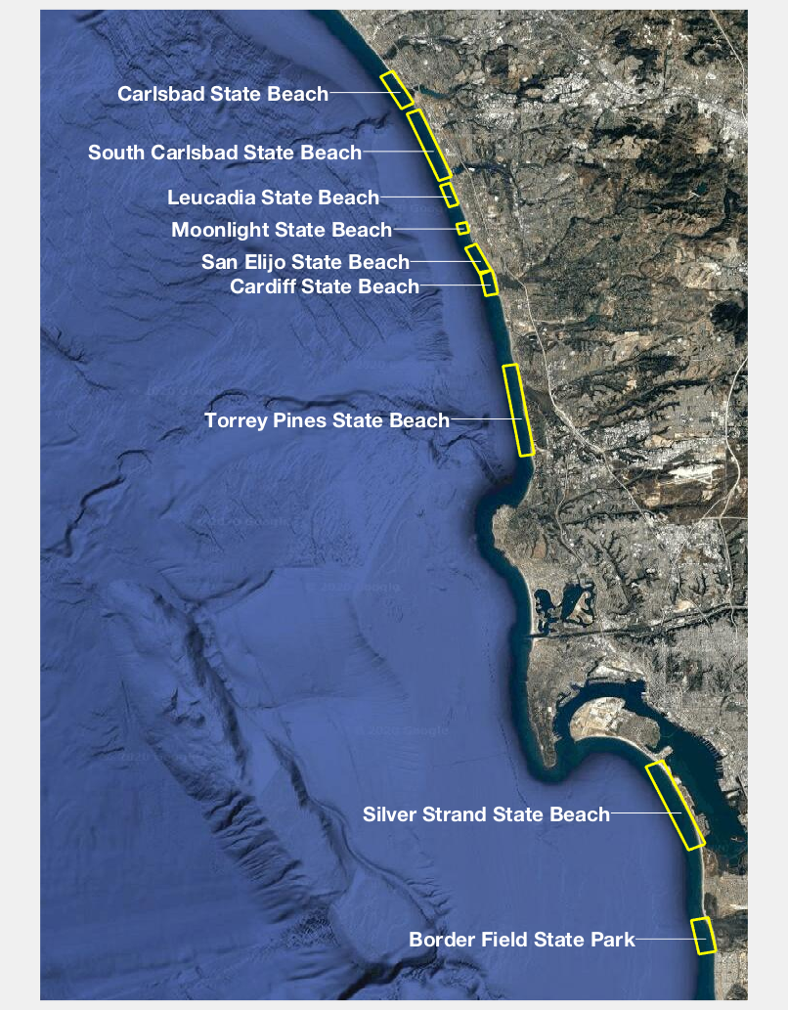
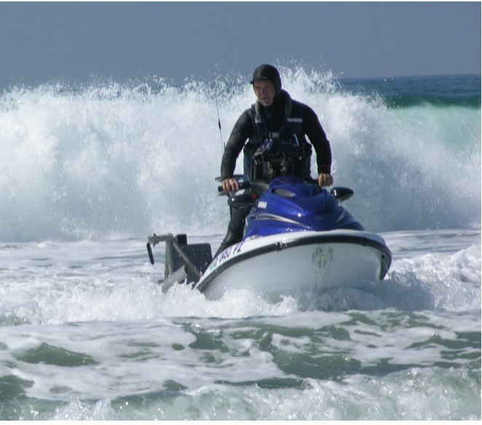
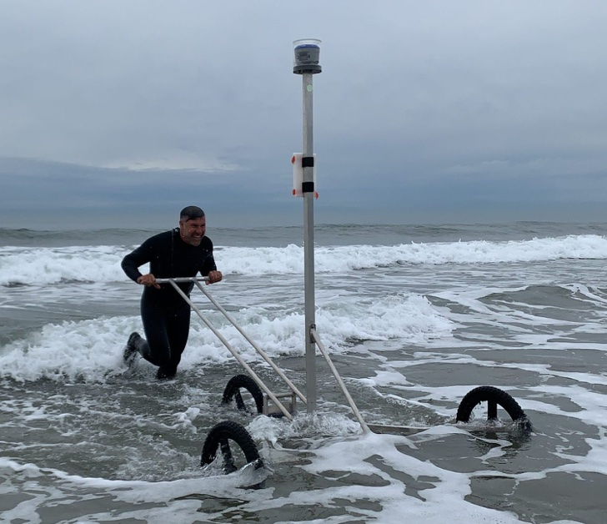
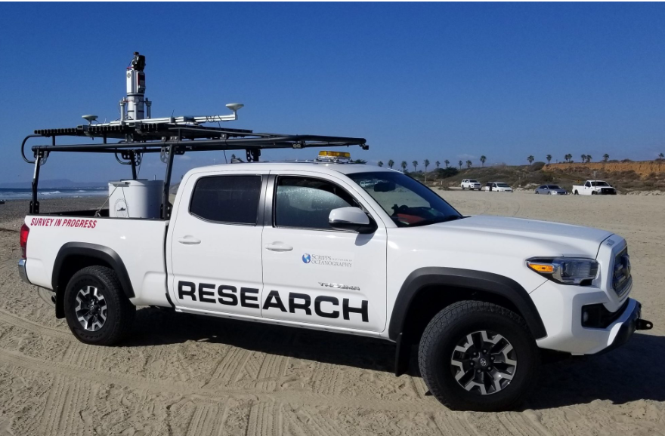
ANNUAL FALL REPORTS at 9 State Beaches in SD County
2024 Report
( Oct 1, 2023 - Sep 30, 2024 )**
North
County
** Report Years are “Beach Years”
to capture complete winter-summer
beach loss-recovery cycles
South
County

Slide 3
Cpg San Diego County survey coverage
Oceanside
- Oceanside
North
County
- Solana Beach
Solana Beach
Del Mar
- Del Mar
Additional Surveyed
Beaches
Included Today
South
County
Imperial Beach
- Imperial Beach

Slide 4
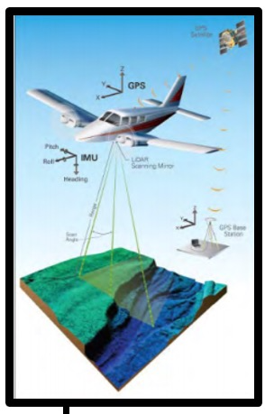
The CPG Long-term FALL lidar Survey Dataset
How are we doing after 2 stormy winters in a row?
Oceanside
Long-Term LiDAR Surveys of
Fall Beach Widths
Fall (Sept-Oct) Beach Surveys
1997-2024
--- Airborne LiDAR --- | -Mobile LiDAR-
1997, 2002-11, 2014-15 2017-24
North
County
Solana Beach
Del Mar
South
County
Imperial Beach

Slide 5
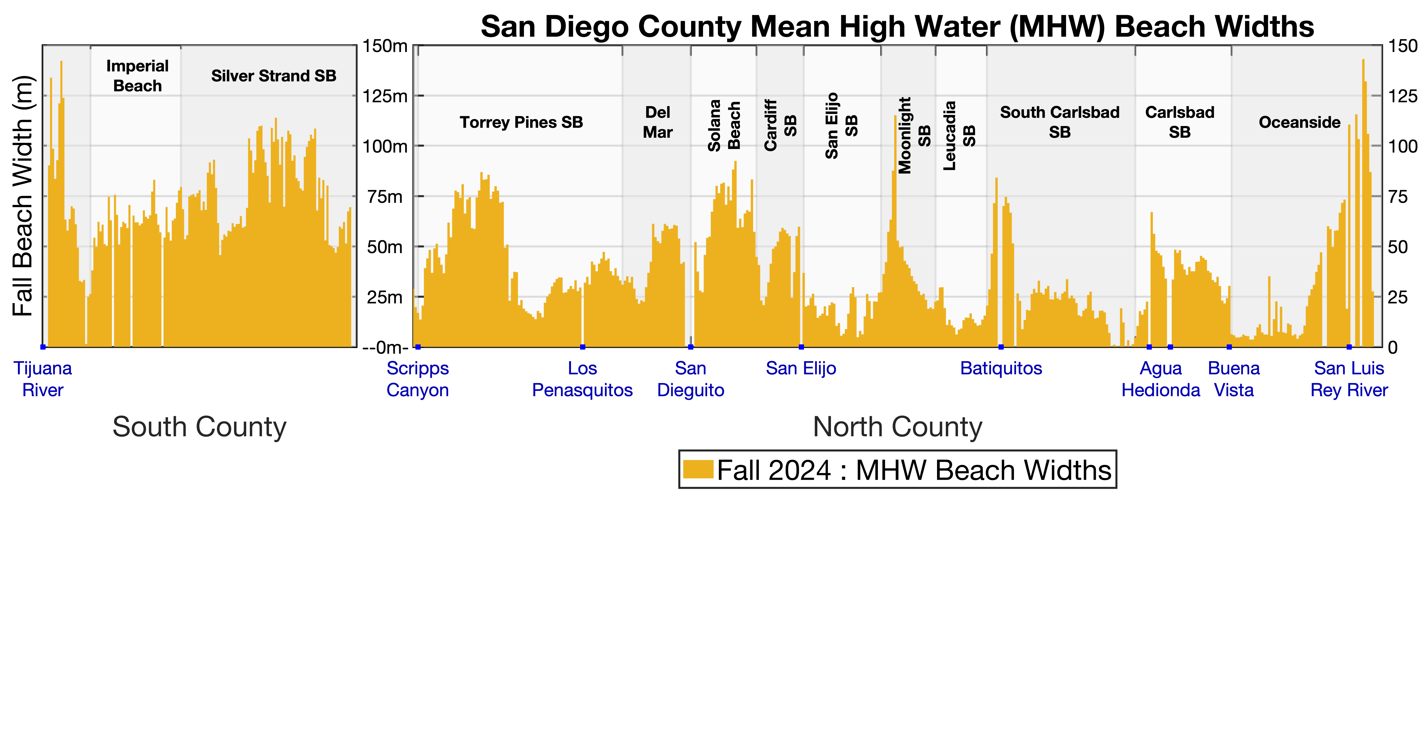
Current State of San Diego County Beaches

Slide 6
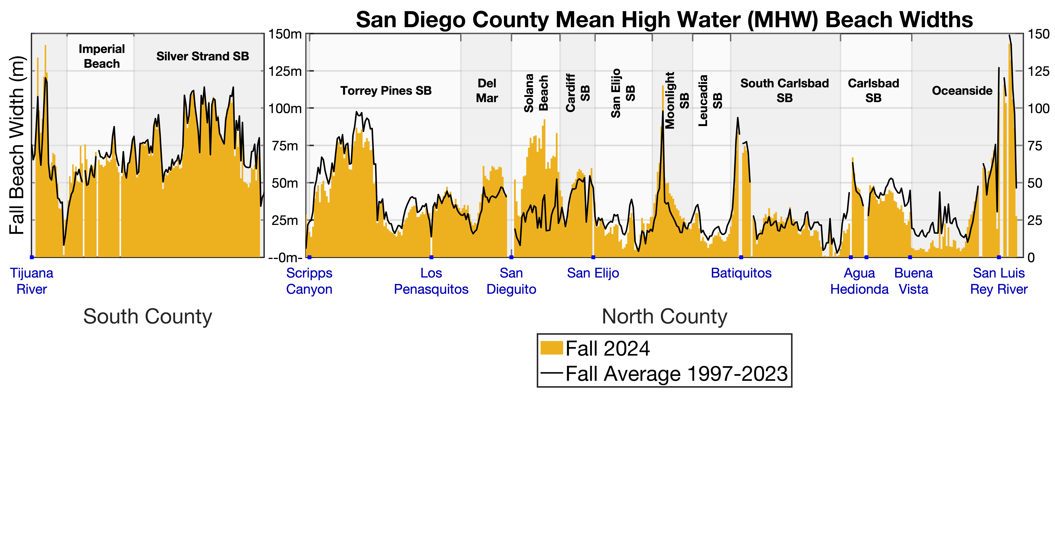
Current State vs. Long-Term Fall Average

Slide 7
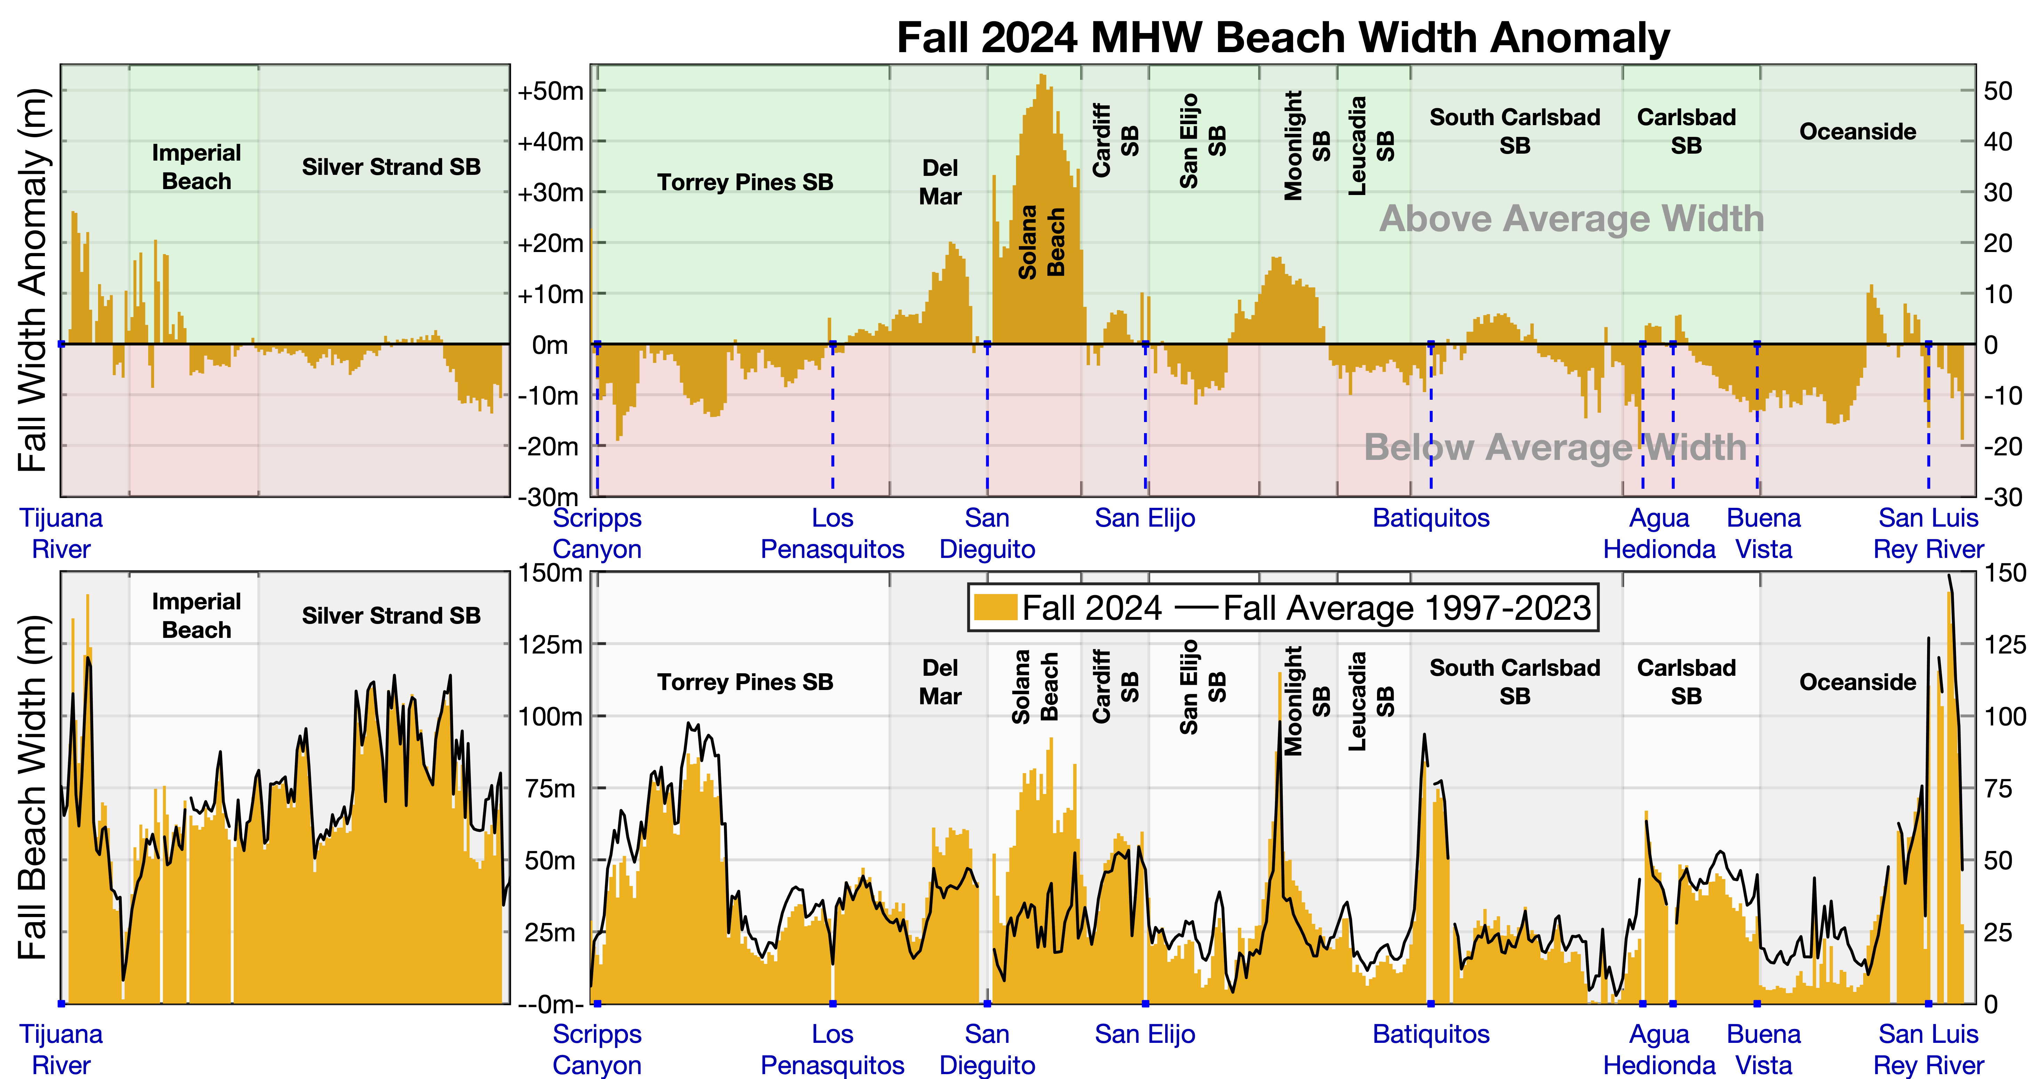
Current State relative to Long-Term Fall Average

Slide 8
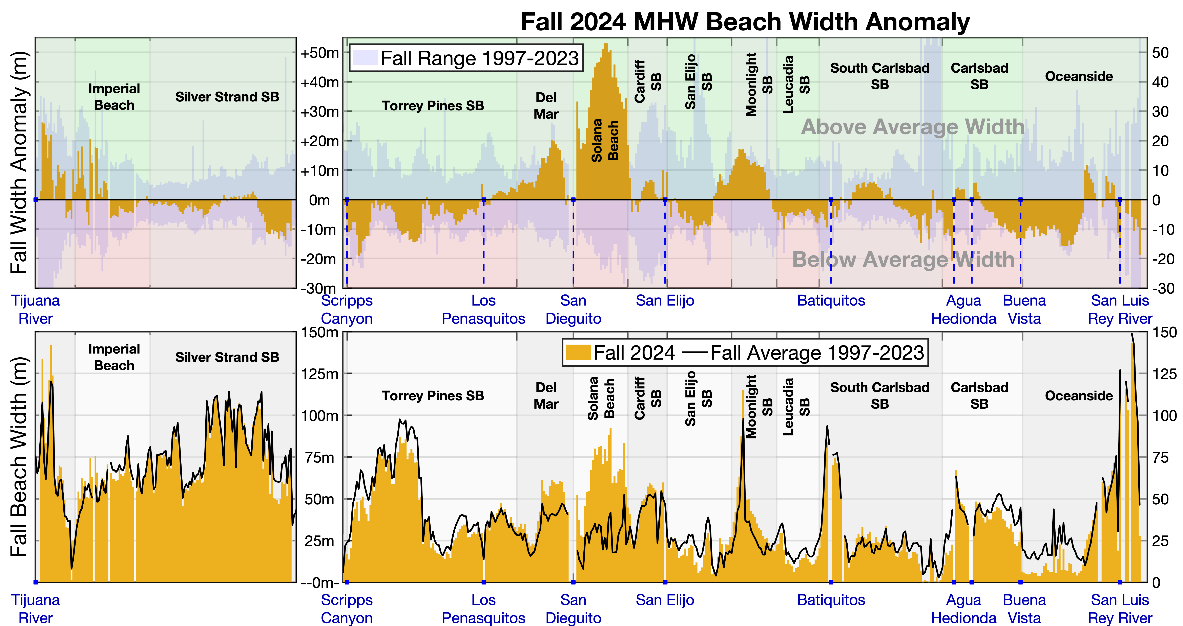
Current State relative to Long-Term Fall Average
and Min-Max Fall Range

Slide 9
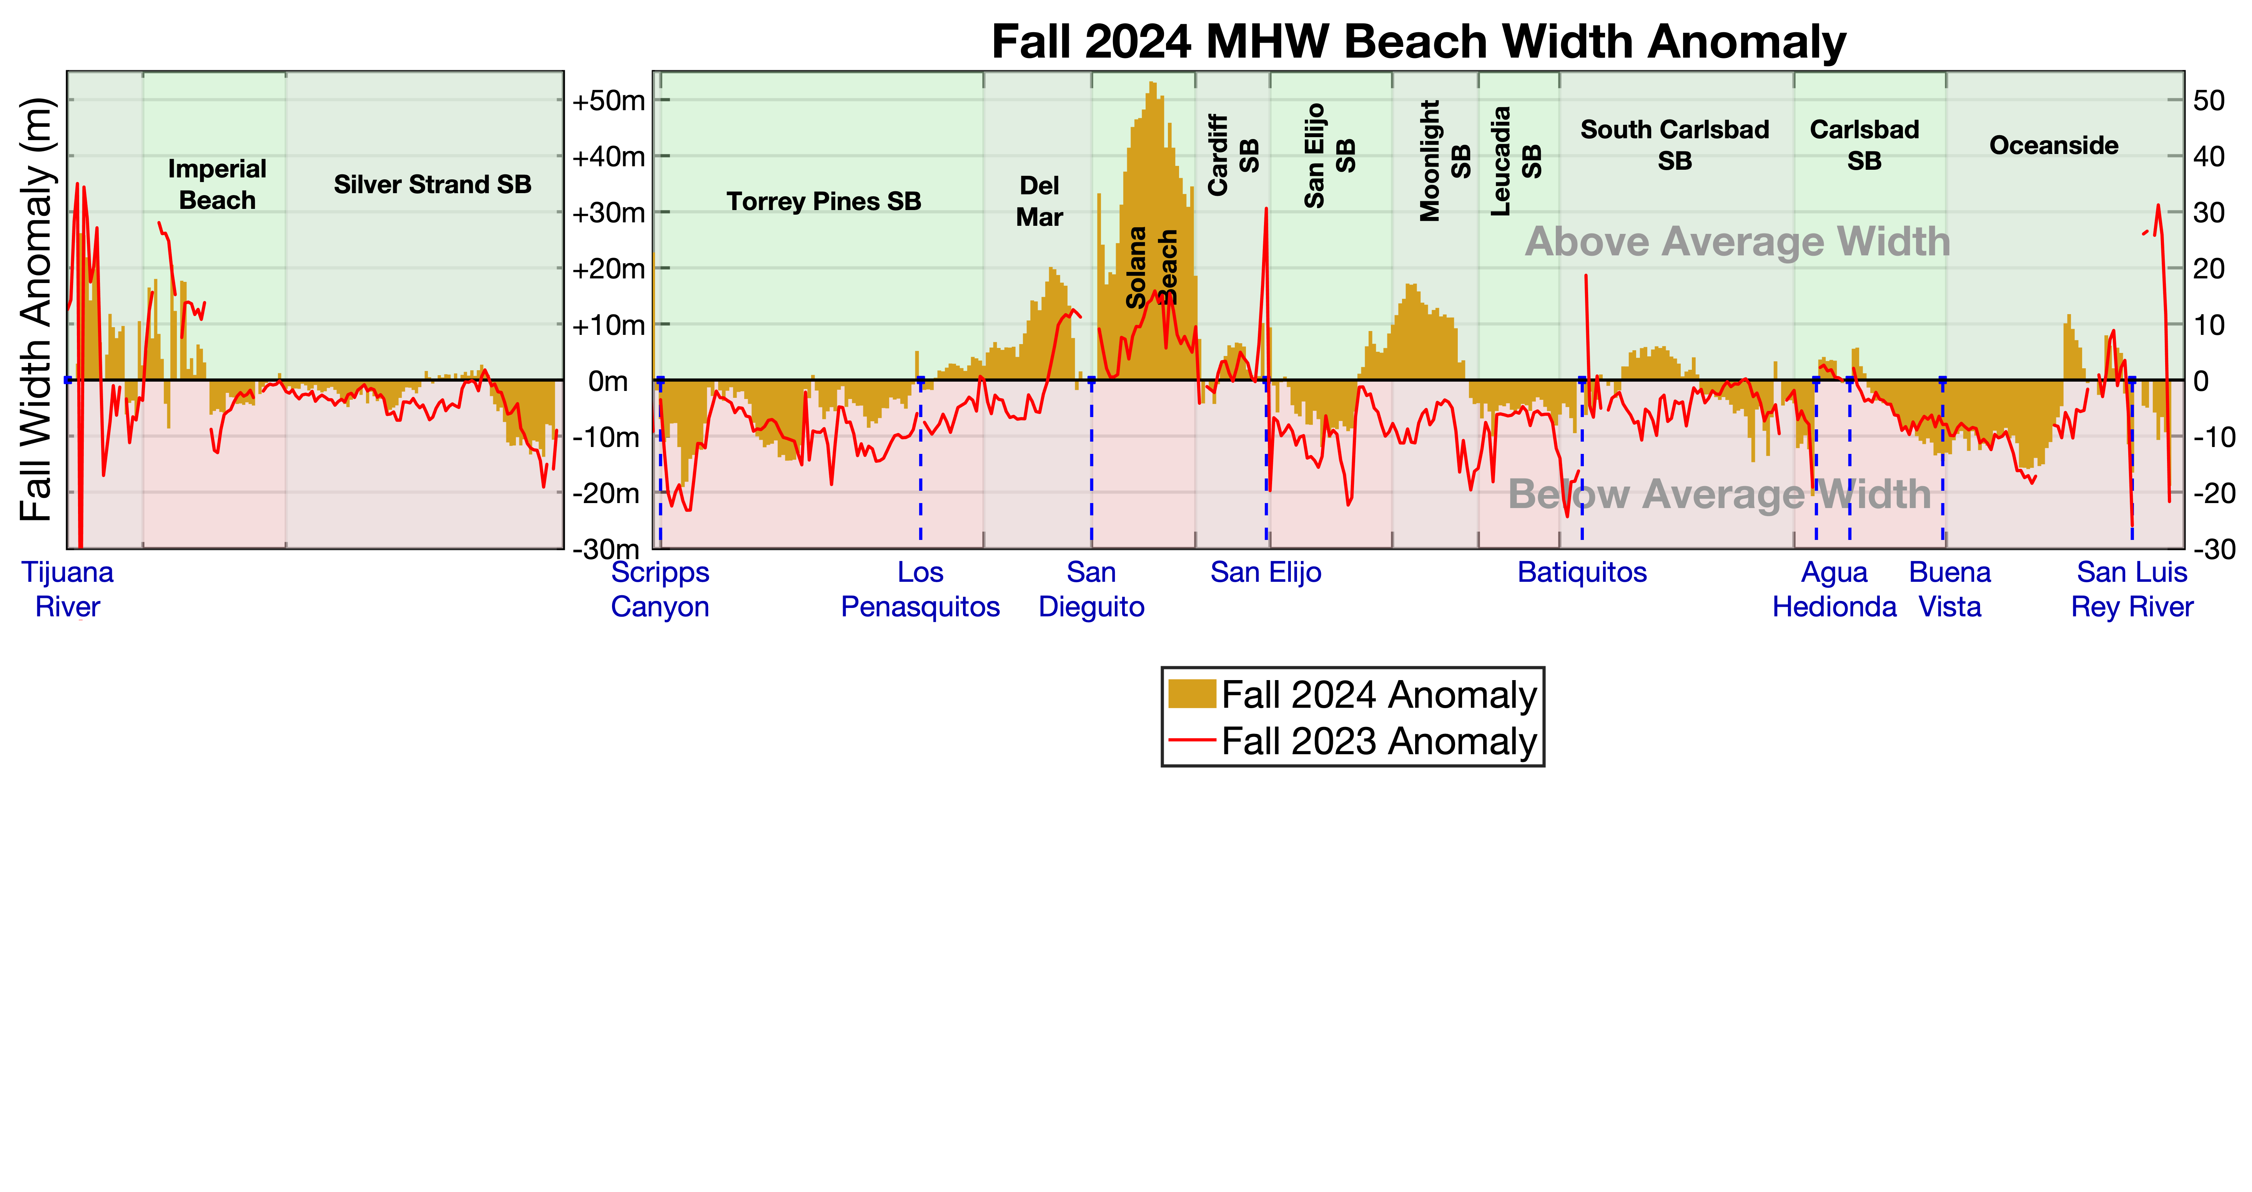
Change from Last Year’s Fall Beach State
Post-Atmospheric River winter
Pre-nourishments
North Del Mar – Solana already above average

Slide 10
** longshore erosion
wave?
How are we doing after 2 stormy winters in a row?
Below Avg Many Places, but Good for an El Niño Year. **

Slide 11
THE cpg long-term nearshore Survey Dataset
Oceanside
Where did the eroded sand go?
Long-Term GPS Surveys of
Nearshore Sand Elevations
Torrey Pines -> Cardiff SB
“Sand Maps”
North
County
Solana Beach
Del Mar
South
County
Imperial Beach

Slide 12
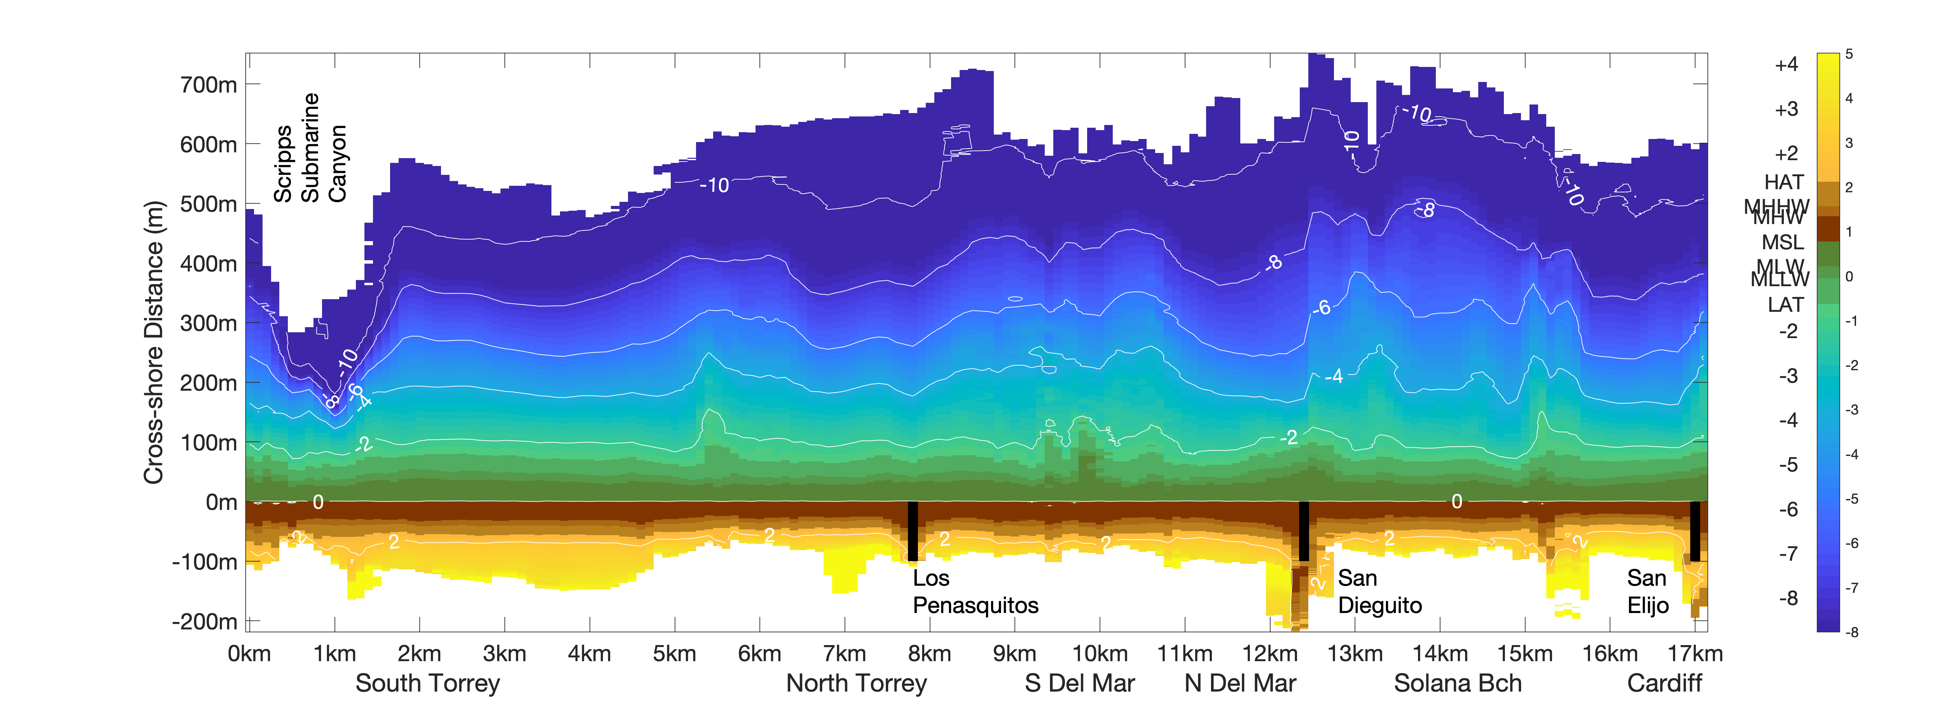
Nearshore Sand Mapping
Reef
Reef
Reef
Reef
Reef
Reef
Torrey Pines to Cardiff SB Nearshore Bathymetry

Slide 13
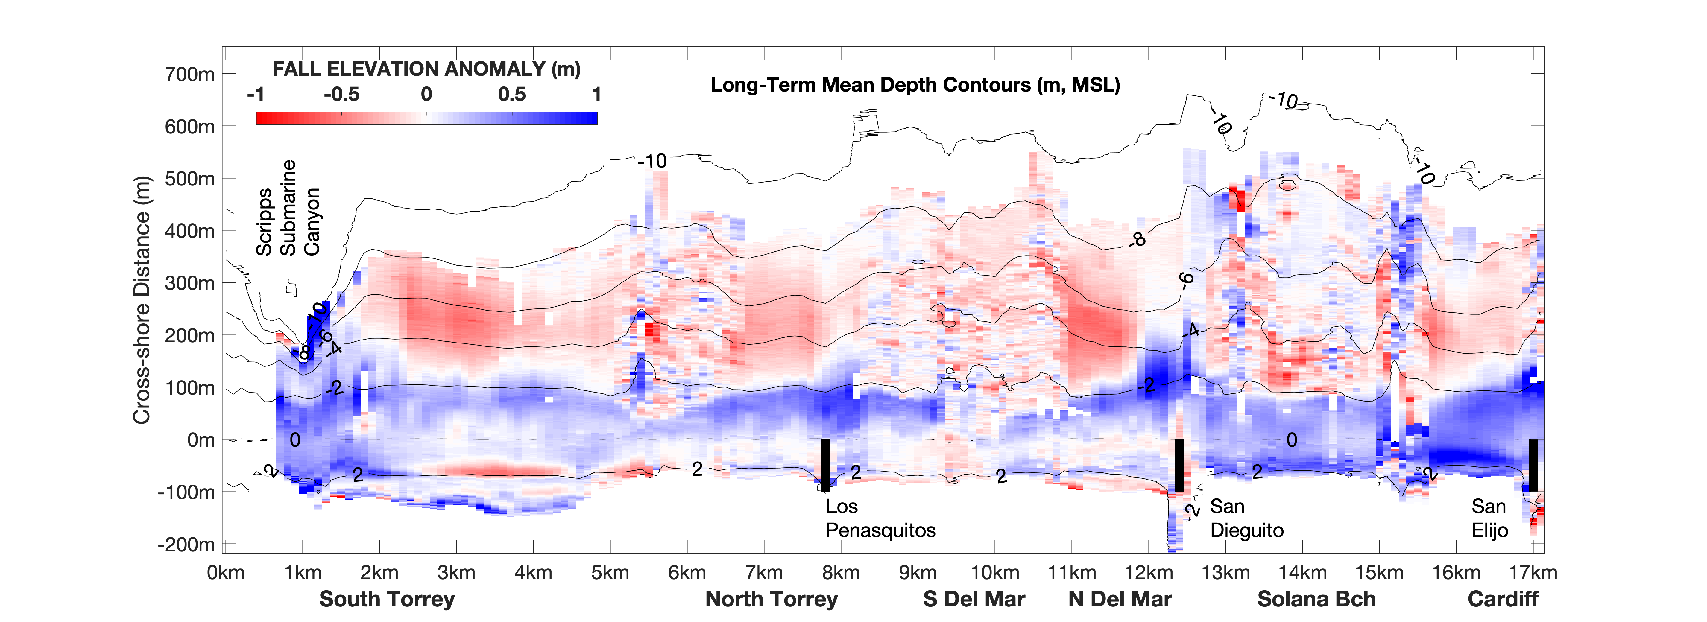
4 Years Ago
North County Fall 2020 Nearshore Sand Map

Slide 14
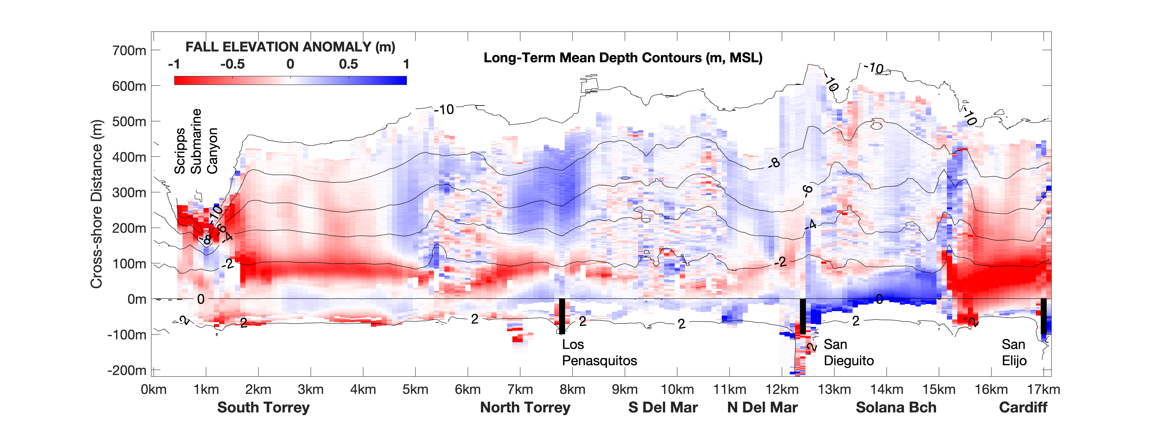
Nourishment
Pad
North County Fall 2024 Nearshore Sand Map

Slide 15
** Permanent Loss
Down Canyon
Where did the eroded sand go?
Nourishment
Pad
It’s Around **
North County Fall 2024 Nearshore Sand Map

Slide 16
Looking Ahead ENSO-style
You Are
Here
●
Beach
Width
●
●
Recovery
Periods
●
●
●
●
●
●
●
1998
2003
2010
2016
2024
2029-2032?
El Niño Years
The ENSO “Sawtooth” Beach Width Cycle

Slide 17
2024-25 Winter Outlook
Current ENSO Forecast : “Weak La Niña”
ENSO Winter Forecast | Historical Winter Wave Conditions in San Diego
El Niño | Above Average Waves almost every year
Weak El Niño | Below Average Waves 2 out of 3 years
Weak La Niña | Above Average Waves 2 out of 3 years
La Niña | Below Average Waves 2 out of 3 years

